Slide 1
IBM University Engagement Project Submission
“Exploring the Power of Agentic AI with IBM Granite and LangFlow”

Slide 2

Project Tile – [Smart Study Generator Agent]
Domain of Project – [Education]
Student Name | Recent Passport Photo | Email ID | Mobile number [WhatsApp]
Sayali Ramesh Barve |  | sayali.barve1505@gmail.com | 9359533125

Slide 3
Problem Statement -
Problem Statement No.13: Smart Study Generator Agent The Challenge Students today face an overwhelming flood of information-lecture notes, textbooks, research papers, YouTube tutorials, and online resources. This content is scattered, unorganized, and often not personalized to their learning pace or style. As a result, students struggle with finding the right study material, summarizing key concepts, and staying exam-ready. Traditional study tools only provide static notes or flashcards, failing to adapt dynamically to student needs. The challenge is to move beyond static resources toward an intelligent, adaptive study companion. The Objective Build an agentic AI-powered Smart Study Generator that personalizes and streamlines learning for students. The solution should: 1. Fuse Learning Resources: Aggregate content from class notes, textbooks, research articles, and online tutorials into structured, easy-to-digest study material. 2. Enable Multimodal Input: Allow students to upload notes, voice queries, or images (e.g.,text book pages), and generate concise summaries, flashcards, or concept maps. 3. Create a Predictive & Agentic Layer: Recommend personalized study plans, highlight important topics based on syllabus or past exams, and provide predictive alerts (e.g., "Focus on Topic X-frequently asked in exams"). 4. Visualize Study Progress: Offer a real-time dashboard showing learning milestones ,weak areas, practice quizzes, and performance forecasts.

Slide 4
Proposed Solution -
AI-Powered Smart Study Generator Agent
The proposed solution is a multi-agent AI-powered Smart Study Generator Agent built using IBM LangFlow, IBM watsonx.ai, IBM Granite Models, and IBM Orchestrate to provide personalized and intelligent learning. The system addresses challenges in organizing study materials, planning revisions, and improving exam preparation through an agentic AI architecture.
At its core, the solution uses Retrieval-Augmented Generation (RAG) to retrieve accurate study content from lecture notes, textbooks, research papers, and online resources. The content is stored in a vector database and summarized using Granite Models.
The system consists of four key agents:
Learning Resource Agent retrieves and summarizes study material using RAG.
Study Recommendation Agent creates personalized study plans based on syllabus, weak areas, and goals.
Predictive Learning Agent identifies important topics, predicts weak areas, and provides revision suggestions.
Study Progress Agent tracks quizzes, learning progress, and provides actionable feedback.
The solution includes a user-friendly dashboard that displays study progress, personalized plans, flashcards, summaries, and performance analytics.
IBM LangFlow manages the agent workflow, watsonx.ai provides AI services and governance, Granite Models power summarization and recommendations, while IBM Orchestrate automates study reminders and learning workflows.
Overall, this solution delivers an end-to-end intelligent study assistant that transforms scattered study resources into personalized learning through AI-powered summarization, adaptive study planning, and real-time progress tracking.

Slide 5
Technology Used
Langflow platform -For designing and orchestrating multi-agent workflows visually
IBM Granite model - for eg – ibm-granite-3-2-8b – For natural language understanding, reasoning, and personalization
IBM Cloud – It provides the infrastructure to build, deploy, and scale the Nutrition Agent efficiently. IBM Cloud enables a reliable, secure, and scalable environment for deploying the Nutrition Agent.
RAG– RAG to fetch real data first, then generate intelligent answers, making the Nutrition Agent more trustworthy and effective.
IBM Watsonx.ai - For model deployment, embeddings, and AI governance
Vector Database (FAISS/Chroma) – For RAG-based nutritional data retrieval
IBM Langflow / IBM Orchestrate + IBM Models

Slide 6
Langflow component Used -
1) Chat Input – Interface where students upload queries, notes, PDFs, textbook images, or voice input.
2) IBM watsonx AI Agent – Processes user input using IBM Granite models to generate summaries, flashcards, concept maps, and study recommendations.
3) IBM Granite Model – Granite-4.0-8B-Instruct → Fast and efficient for summarization, question answering, and personalized study planning.
4) Chat Output – Displays AI-generated summaries, flashcards, concept maps, personalized study plans, and learning insights.
5) File Component – Stores and retrieves lecture notes, textbooks, PDFs, research papers, and other study resources for RAG-based retrieval.
6) Vector Store (Knowledge Base) – Stores embeddings of study materials, enabling fast semantic search and accurate Retrieval-Augmented Generation (RAG).

Slide 7
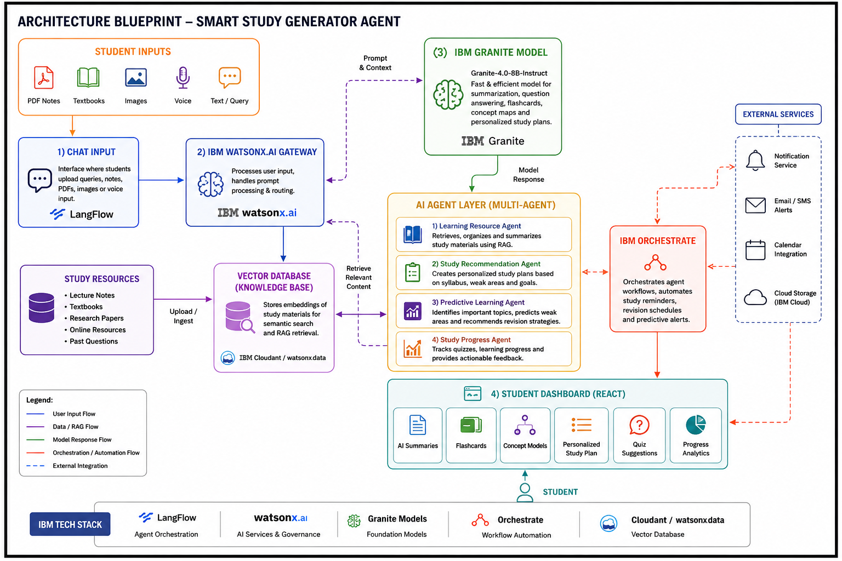
Architecture blueprint

Slide 8

Role of Agentic AI in the solution
Role of Agentic AI in the Solution
Agentic AI in Smart Study Generator Agent
The proposed Smart Study Generator Agent leverages Agentic AI, Retrieval-Augmented Generation (RAG), and IBM Granite Models to deliver an intelligent and personalized learning experience.
Multi-Agent Intelligence – Specialized AI agents collaborate to retrieve study materials, generate summaries, recommend study plans, predict weak areas, and track learning progress.
RAG-Based Learning – Retrieves accurate and relevant content from lecture notes, textbooks, research papers, and online resources, ensuring reliable AI-generated responses.
Personalized Study Plans – Creates adaptive study schedules based on syllabus, learning pace, exam dates, weak topics, and individual learning goals.
Multi-Modal Input – Supports text, voice, PDFs, images, and handwritten notes for flexible learning.
Predictive Learning – Identifies important topics, predicts weak areas, and recommends revision strategies based on student performance.
Real-Time Progress Tracking – Continuously monitors quizzes, study progress, and milestones while providing actionable feedback and analytics.
Scalable & Enterprise-Ready – Powered by IBM watsonx.ai, IBM Granite Models, LangFlow, and IBM Orchestrate for secure, scalable, and efficient AI workflows.
Result: A smart, adaptive, and AI-powered study assistant that goes beyond static learning tools by providing personalized guidance, intelligent recommendations, and real-time progress tracking.

Slide 9
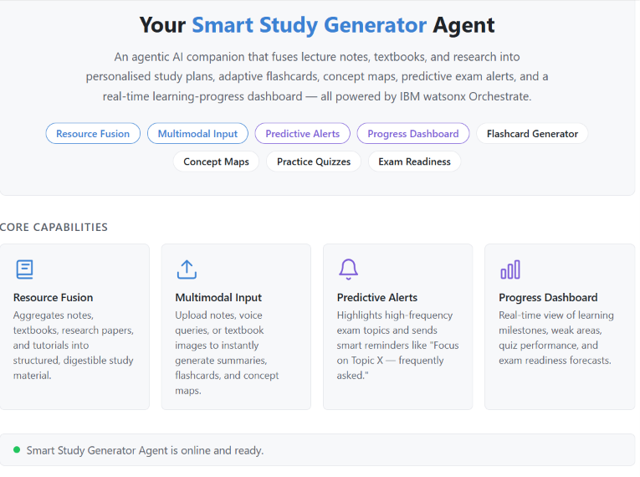
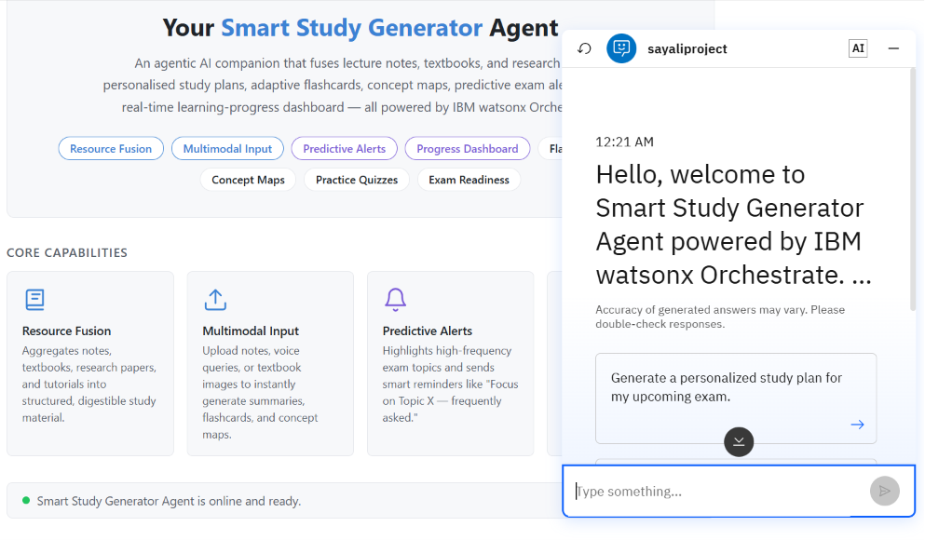
Token Usage
Before Prompt
After the Prompt
·
·
·

Slide 10
Novelty and Uniqueness
The proposed Nutrition Agent stands out by combining Agentic AI, RAG, and personalization into a single intelligent system.
Multi-Agent Intelligence – Instead of a single chatbot, multiple specialized agents collaborate to deliver accurate and context-aware nutrition guidance.
RAG-Based Accuracy – Integrates real-time data retrieval with AI generation, reducing misinformation and ensuring trustworthy recommendations.
Hyper-Personalization – Tailors diet plans based on health conditions, cultural preferences, and fitness goals.
Real-Time Feedback Loop – Continuously adapts recommendations based on daily food logs and user behavior.
Multi-Modal Input – Supports text, voice, and image-based meal tracking for better usability.
Preventive Healthcare Focus – Goes beyond diet planning to provide disease-specific nutrition advice.
Scalable & Enterprise-Ready – Built on IBM watsonx.ai with IBM Granite models, ensuring reliability and governance.
This makes the solution a smart, adaptive, and proactive digital nutritionist, not just a static diet recommendation tool.
change

Slide 11
Git Hub Link
Please test and Paste the working GitHub URL – https://github.com/Saya1i/projectibm.git

Slide 12
Future Scope
1. AI Tutor & Doubt Solving
Enhance the system with an AI tutor that provides real-time doubt resolution, explains difficult concepts, and generates practice questions with detailed solutions to improve learning outcomes.
2. Voice Assistant & Multilingual Support
Integrate a voice-enabled assistant with multilingual capabilities, allowing students to interact naturally in their preferred language and making the platform more accessible and inclusive.
3. LMS & Cloud Integration
Integrate with Learning Management Systems (LMS) such as Moodle, Google Classroom, and Microsoft Teams to automatically import study materials, assignments, and deadlines for seamless learning.
·
·
·

Slide 13
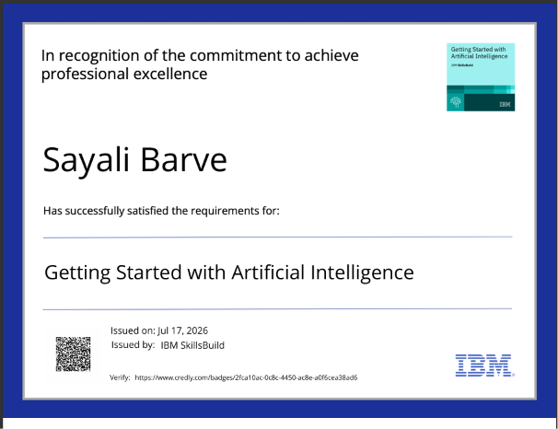
Certificates Earned:
Please add your credly certificate

Slide 14
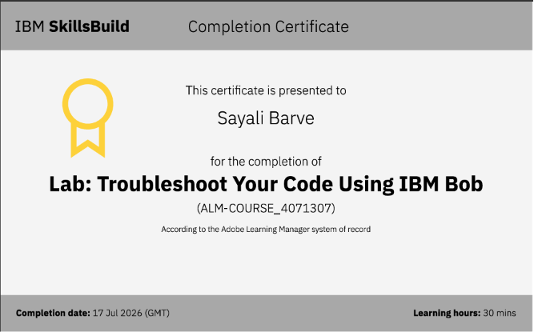
Certificates Earned:​
Add your IBM BOB Certificate

Slide 15


